Slide 1
QUESTION
Would you believe me if I told you that your loved ones medical devices could be hacked at any moment?
Notes:
For those of you who have played any kind of video game, do you find yourself absorbing more information and adjust to changes quicker?”

Slide 2
CYBERBLOCK
By: Zach Kelly, Xin (Jason) Li, Ridhisha Dangol, and Nelson Lau
Notes:
My name is Zach, and I am here with Ridhisha, Nelson, and Jason. We are the development team behind CyberBlock.
For some background, CyberBlock is a card game created by Medtronic to teach students about cybersecurity. Students form teams and must use defense cards to block incoming cyber attacks. Teams have a limited amount of money to buy defenses so they must choose their defenses carefully.

Slide 3



Level 01
Project Problem
Notes:
In our project there were a few problems that we had to face.

Slide 4
PROBLEM
BASED OFF CARD GAME
REMOTE PLAY
01
04
EXPANDABLE
02
05
DIFFICULTY SCALE
REAL-WORLD PROBLEMS
03
06
FUN EXPERIENCE
CyberBlock Card Game Created at Medtronic
Can Play Anywhere with a other Players
Not Restricted to Paper-Based Game
Options for Beginner, Intermediate, and Advanced
Attacks and Defenses Happen in the Medical Device Industry
Players Should Enjoy and Have a Memorable Game
Notes:
We were tasked with building on their original CyberBlock game.
They wanted the game to be more expandable than the current paper version, and they decided that a digital game would be a perfect fit.
They want the ability to update the game with new attacks and defenses to match changes in the medical device industry.
They also wanted remote access so that students anywhere can participate.
They wanted variable difficulty so that more experienced players can still have the opportunity to learn.
And finally, they wanted to make sure that the game is a fun and memorable experience.
Now onto Jason for our project solutions.

Slide 5
Project Solutions
Level 02
Notes:
5 seconds

Slide 6
SOLUTIONS
CONNECTION
CHAT
DATABASE
Web-based
Server and client
Store Attacks & Defenses
Multiple difficulties
SCORE POINTS
Chat with team
Chat with lobby
Leaderboard displays all scores
Notes:
1 minute

Slide 7
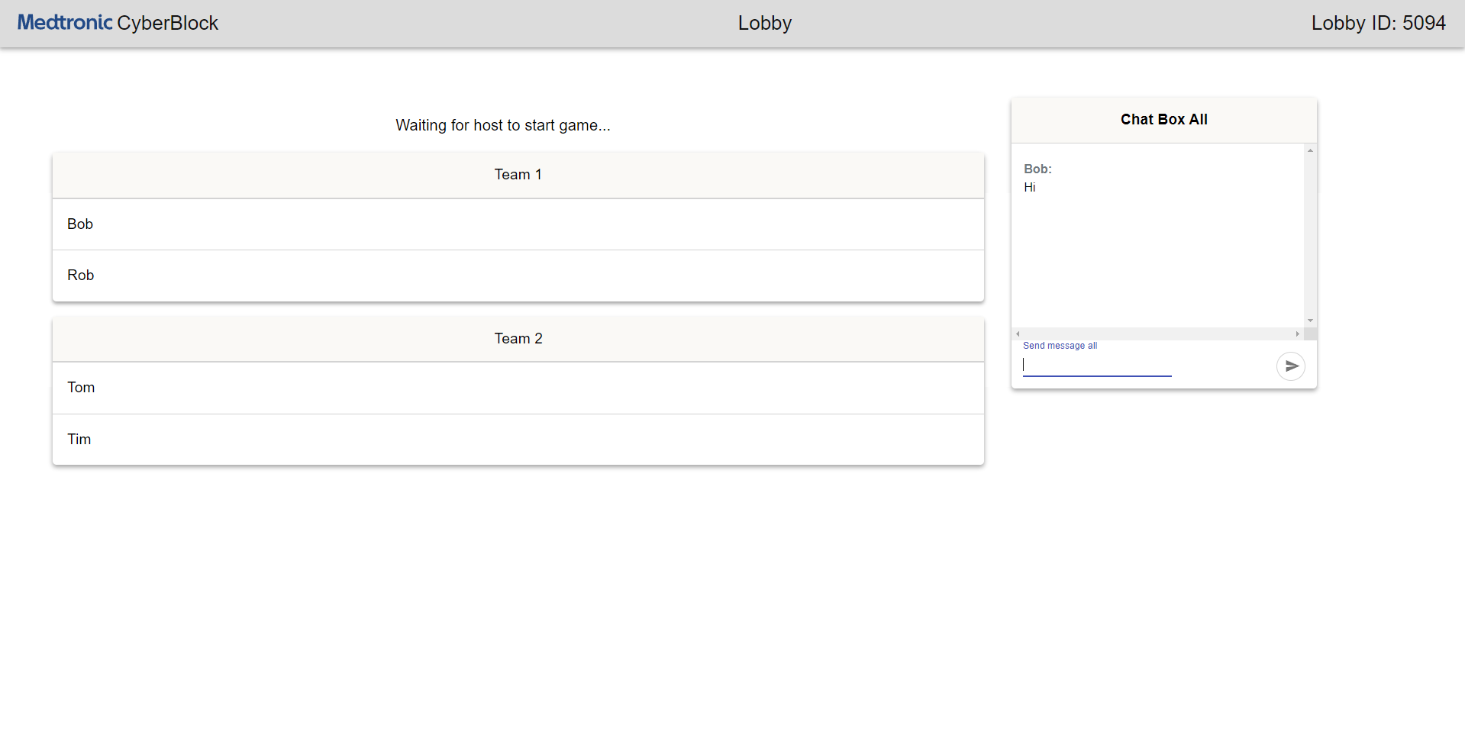
TEAM SELECTION
Notes:
30 seconds

Slide 8
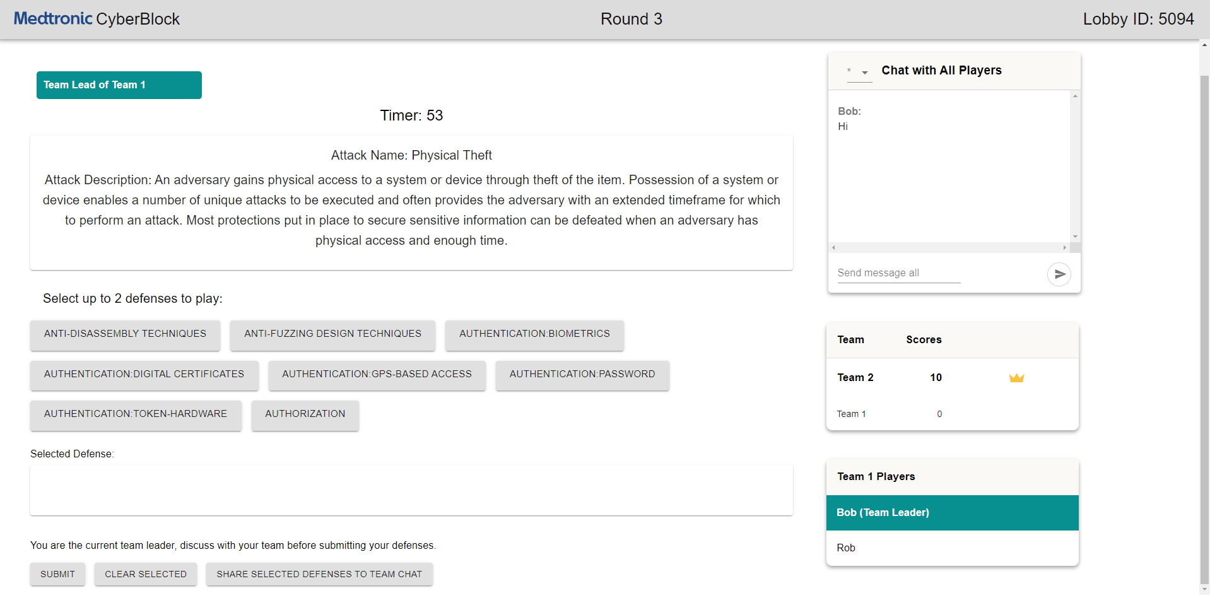
GAMEPLAY
Notes:
30 seconds

Slide 9
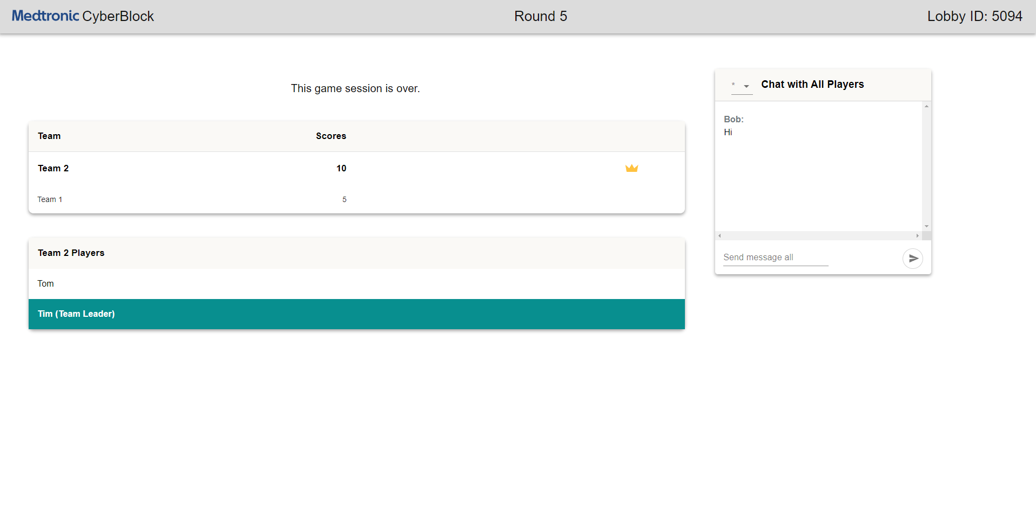
SCOREBOARD
Notes:
30 seconds

Slide 10
Challenges
Level 03

Slide 11
CHALLENGES
CONNECTION
DATABASE
CHAT
SCORE POINTS
Instance Detection
Stays Connected till the End of the Game
Remote Connection
Code Implementation
Place Can Discuss with Teammates and All Chat
Integrated Chat Box
Award Points for Proper Defense
Keep Track of Total Points Scored
Notes:
1 minute

Slide 12
Testing
Level 04

Slide 13
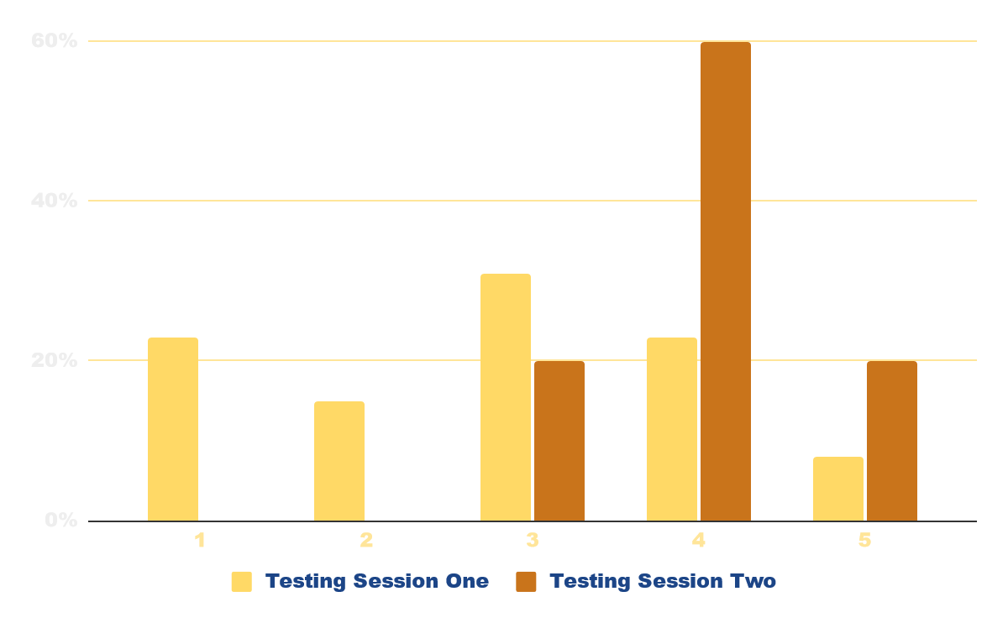
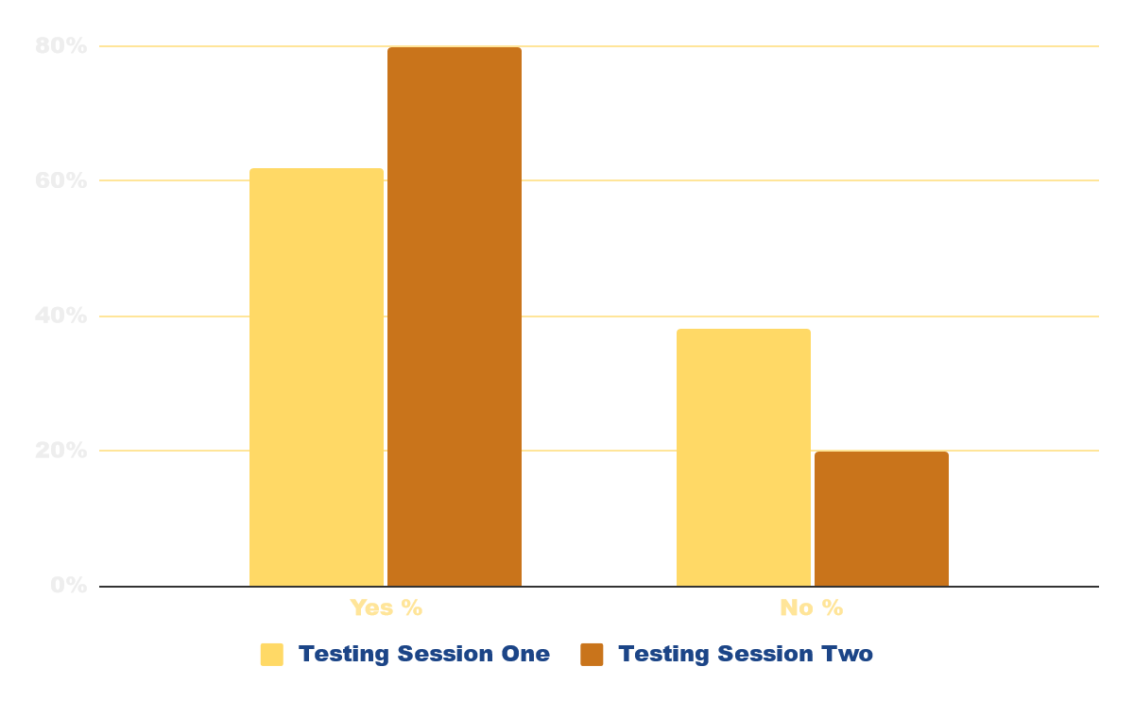
COMPARING RESULTS
Rate the overall competitiveness of all games?
Were you able to learn about cyber attacks and how to defend against them?
Testing Session One
Testing Session Two
Testing Session One
Testing Session Two

Slide 14
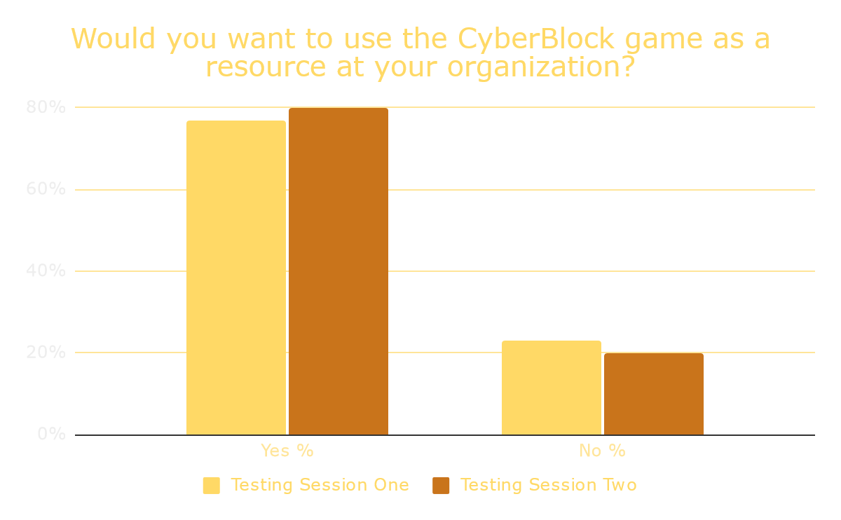

Slide 15
Global Impact
Level 05
Notes:
5 seconds

Slide 16
STUDENTS AND WORKER
SARAH SMITH
Student in the Medical Device Security Field
Was More Attentive When Playing CyberBlock
Learned How to Handle a Wide Variety of Cyber Attacks
Able to Prevent Future Cyber Attacks to Medical Devices from Playing
Notes:
1 minute

Slide 17
THANK YOU ANY QUESTIONS?

